Slide 1

A MINI PROJECT ON Toward Detection and Attribution of Cyber-Attacks in IoT-enabled Cyber-physical Systems (Submitted in partial fulfilment of the requirements for the award of Degree) BACHELOR OF TECHNOLOGY IN COMPUTER SCIENCE AND ENGINEERING BY BATCH:21 paindla saketh 207R1A05N0 gajawada rahul 207R1A05L1 Under the Guidance of m.madhusudan DEPARTMENT OF COMPUTER SCIENCE AND ENGINEERING CMR TECHNICAL CAMPUS UGC AUTONOMOUS (Accredited by NAAC, NBA, Permanently Affiliated to JNTUH, Approved by AICTE, New Delhi) Recognized Under Section 2(f) & 12(B) of the UGC Act.1956, Kandlakoya (V), Medchal Road, Hyderabad-501401. 2020-2024.

Slide 2

AIM OF THE PROJECT
To Develop Cyber-physical systems (CPS) for Detecting and attributing cyber-attacks in IoT-enabled networks.

Slide 3
abstract
Securing Internet of Things (IoT) can be challenging, as security may not be as effective in a CPS settings.
So, there is a need for effective cyber-attack detection and attribution in Internet of Things (IoT) enabled cyber-physical systems (CPS).
The cyber-attacks can disturb critical services ,loss of confidential information.
There is a two-level ensemble attack detection and attribution framework designed for CPS.
At the first level, a decision tree combined with deep representation- learning model is developed for detecting attacks.
At the second level, a deep neural network is designed for attack attribution.

Slide 4
EXISTING SYSTEM
Machine learning algorithms for attack detection are random forest (RF) algorithm, followed by artificial neural network (ANN).
To overcome the issue of imbalanced data, oversampling is used to achieve balance in the dataset.
The KNN algorithm is used for attack detection to achieve high accuracy, precision and recall.
A Logical Analysis of Data extracts patterns/rules from sensor data and uses them to design a two-step anomoli detection system.
Oversampling and other data balancing techniques can help mitigate issues related to imbalanced data.

Slide 5
DISADVANTAGES OF EXISTING SYSTEM
Limited Scalability(LOW EFFICIENCY) : Large scale attacks cannot be handled. It is difficult to detect and attribute cyber-attacks in real-time.
False Positives(LESS ACCURACY):Sometimes, it will fail to detect the attack.
Privacy Concerns: Existing systems may not be able to protect private data from cyber-attacks or unauthorized access.

Slide 6
PROPOSED SYSTEM
There are less number of ML-based malware attack attributions, designing robust and effective for IoT systems.
Implementation of two-stage deep learning based attack detection and attack attribution framework for ICS with GRU Algorithm.
This approach incorporates both process and physical data to solve the imbalanced data problem without sub-sampling or over-sampling.
The proposed framework utilizes an unsupervised learning representations from normal and attack instances for attack detection.
It forms a two-part RNN to attribute the samples into their corresponding attack attribution.

Slide 7
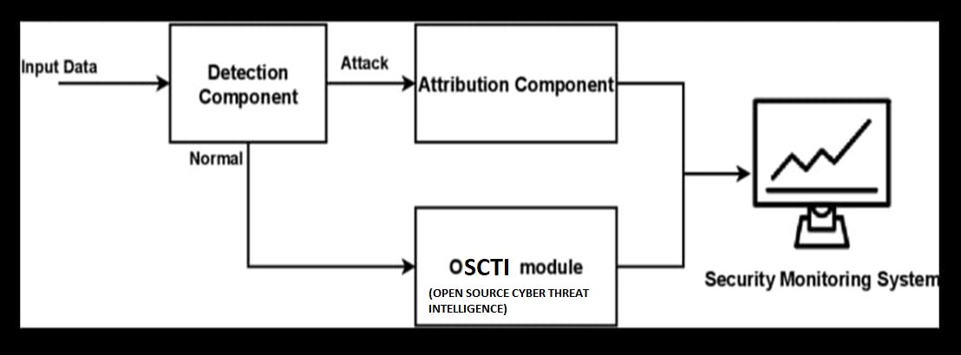
DETECTION AND ATTRIBUTION

Slide 8
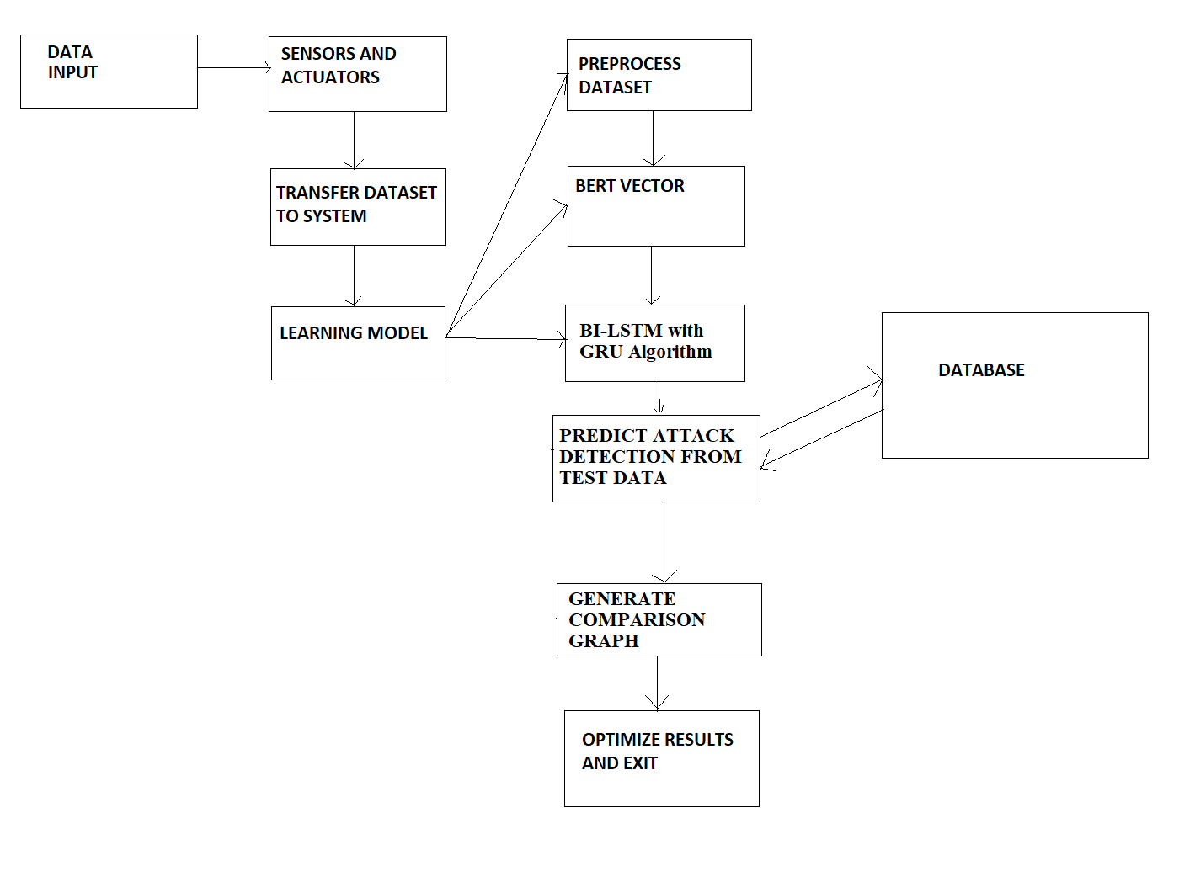
SYSTEM ARCHITECTURE

Slide 9
ADVANTAGES OF PROPOSED SYSTEM
Early Detection of Cyber-Attacks : It provides warning to prevent or mitigate the impact of the attack.
Real-time Monitoring: The system continuously monitors ,if any unusual activity or behavior happens it will indicate.
Cost-Effective: It does not require the deployment of additional hardware or infrastructure.
High Efficiency.
High Accuracy.

Slide 10

Software requirements
Operating Systems : Windows8 or Above.
Coding Language : Python.

Slide 11

HARDWARE REQUIREMENTS
Processor : i3 or Above.
RAM : 4 GB.
Hard Disk : 40 GB.

Slide 12
modules
7 modules are used to run this project:
Upload APT Attack Dataset()
Read Dataset()
Knowledge Graph from Dataset()
Preprocess Dataset()
Run BI-LSTM with GRU Algorithm()
Comparison Graph()
Attack Detection from Test Data()

Slide 13
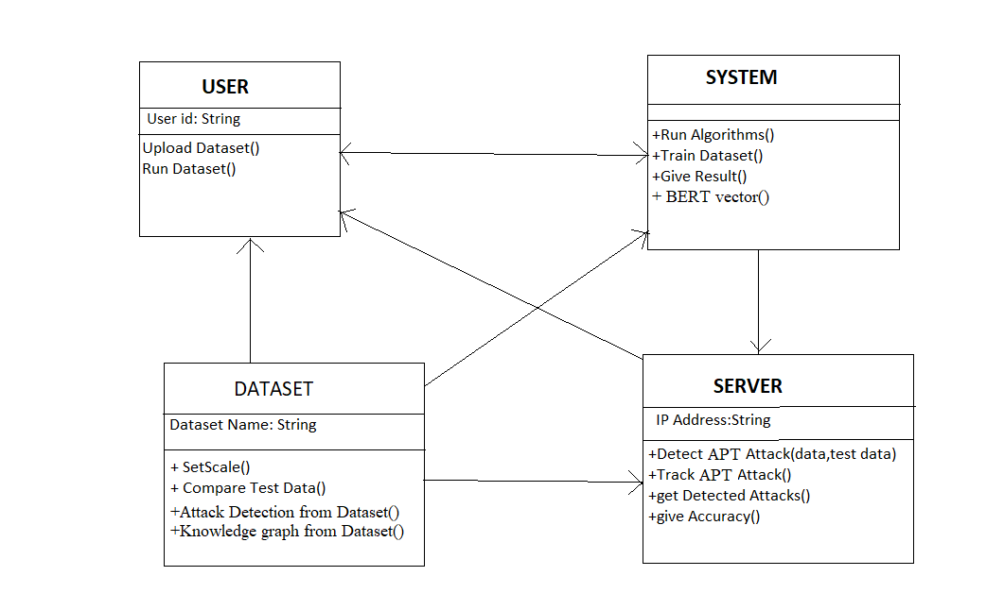
UML DIAGRAMS
CLASS DIAGRAM

Slide 14
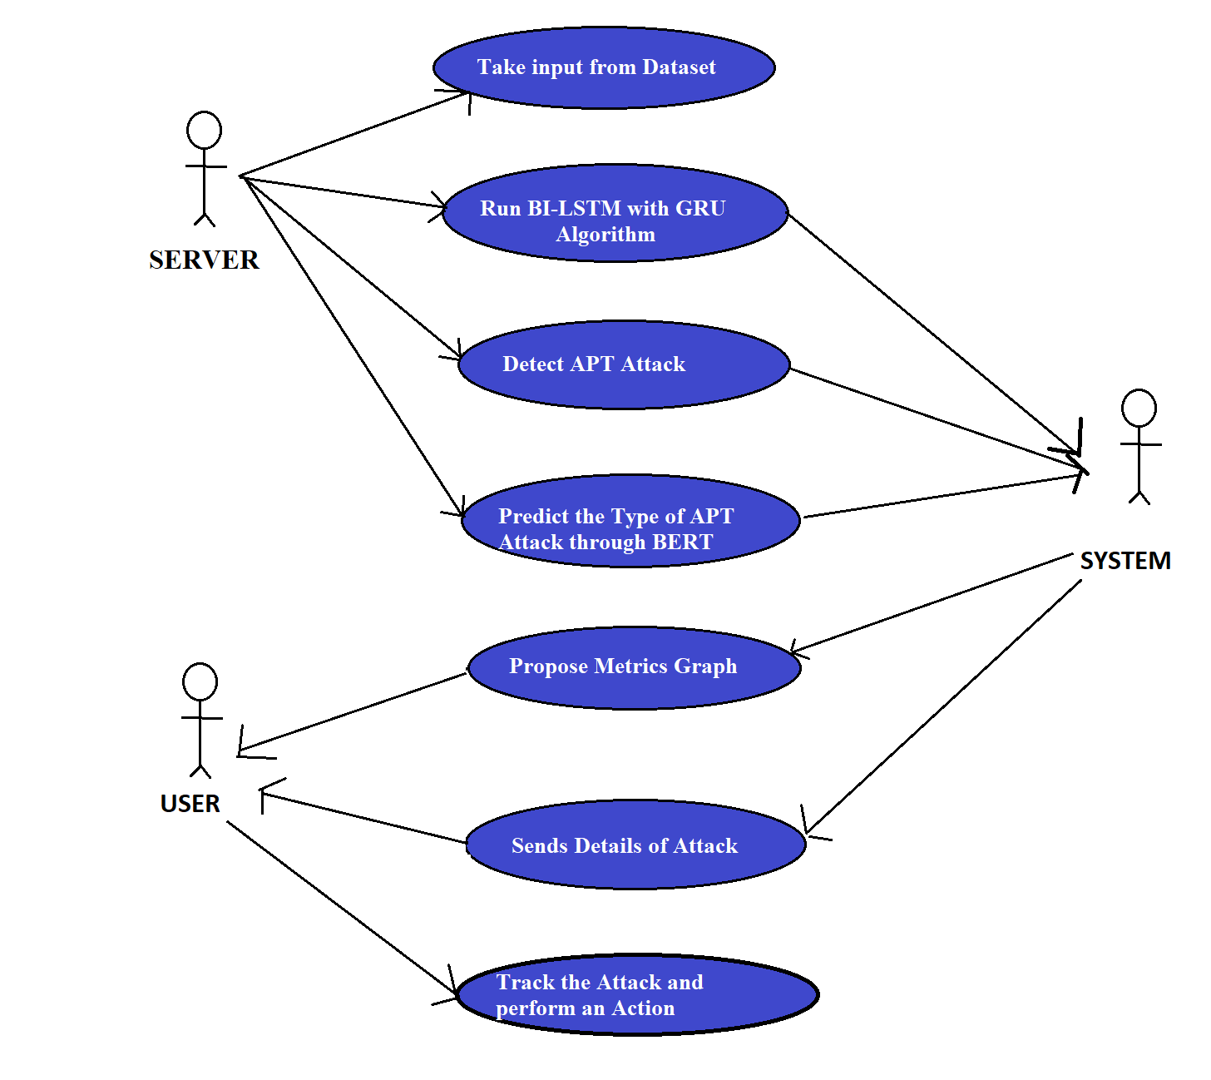
USECASE DIAGRAM

Slide 15
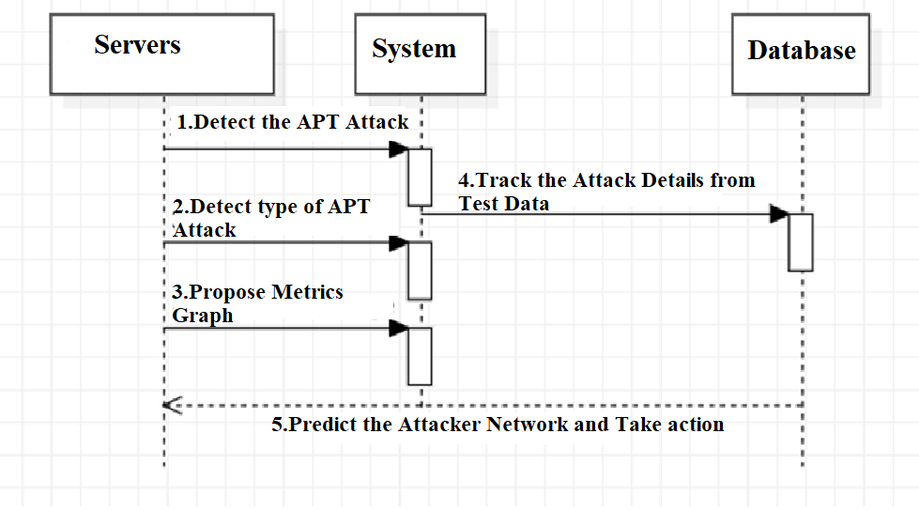
SEQUENCE DIAGRAM

Slide 16
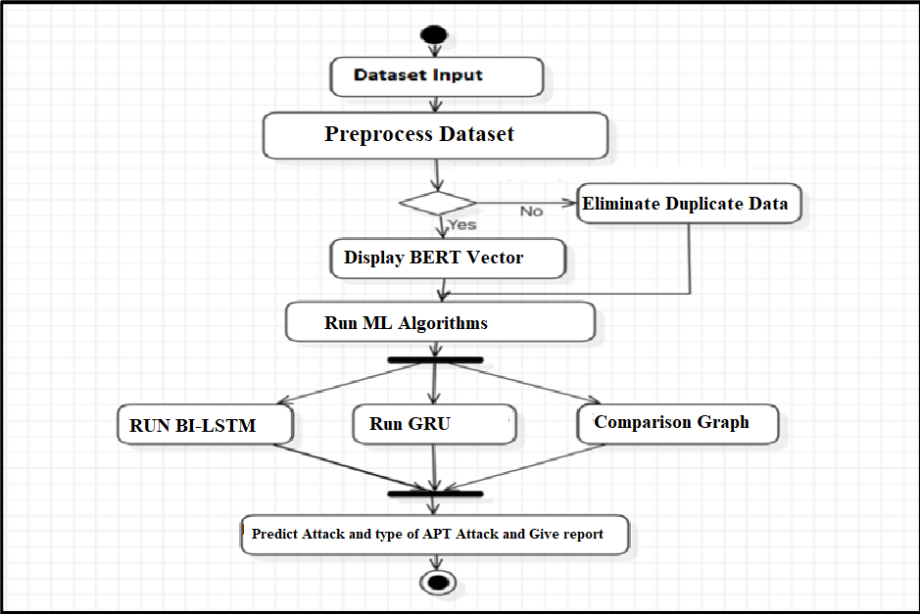
ACTIVITY DIAGRAM

Slide 17
Novelty of project
The Unique characteristics such as heterogeneity, complexity and inter-connectedness pose significant security for IoT-enabled cyber-physical systems (CPS).
Detection involves identifying ongoing attacks, whereas attribution involves identifying the attacker, responsible for the attack.
Machine learning can learn from data and adapt to changing conditions, making it well-suited for cyber-security applications.

Slide 18
SAMPLE CODE
import matplotlib.pyplot as plt
import pandas as pd
import numpy as np
main = tkinter.Tk()
main.title("CSKG4APT: A Cybersecurity Knowledge Graph for Advanced Persistent Threat Organization Attribution") #designing main screen
main.geometry("1000x650")
global dataset, X, Y, bilstm
global X_train, X_test, y_train, y_test
global accuracy, precision, recall, fscore, labels, scaler, le1, le2

Slide 19
SAMPLE CODE
def loadDataset():
global dataset, labels
filename = filedialog.askopenfilename(initialdir="Dataset")
text.delete('1.0', END)
text.insert(END,filename+" loaded\n\n");
dataset = pd.read_csv(filename)
text.insert(END,str(dataset.head()))
labels = np.unique(dataset['apt'])
label = dataset.groupby('apt').size()
label.plot(kind="bar")
plt.title("APT attacks found in Dataset")
plt.show() os

Slide 20
SAMPLE CODE
def graph():
global accuracy, precision, recall, fscore
height = [accuracy, precision, recall, fscore]
bars = ('Accuracy','Precision','Recall','FScore')
y_pos = np.arange(len(bars))
plt.bar(y_pos, height)
plt.xticks(y_pos, bars)
plt.xlabel("Comparison Matrics")
plt.ylabel("Metric Values")
plt.title("Propose Bi-LSTM with GRU Layer Comparison Graph")
plt.show()

Slide 21
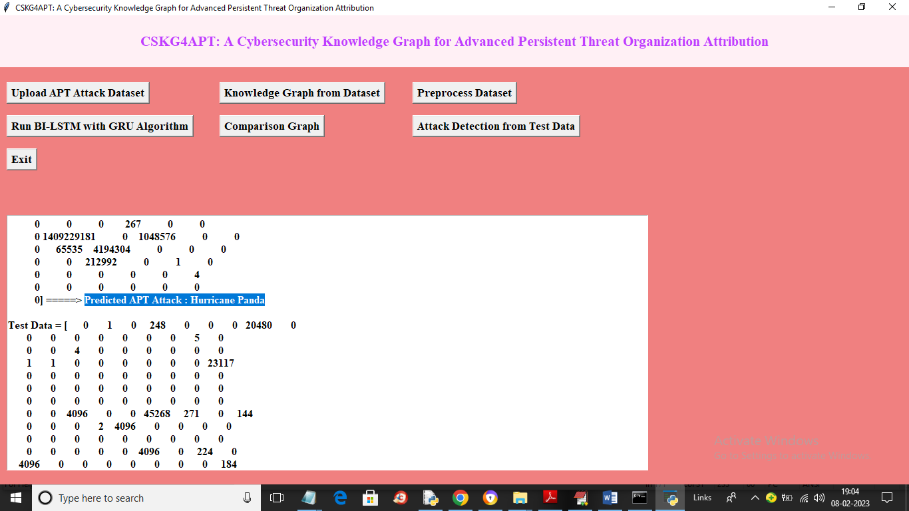
RESULTS
Predicted Attack Hurricane panda
1.Improved efficiency in predicting and detecting attacks.
2. Early Attack Detection: Successful detection techniques enable early identification of cyber-attacks, allowing for timely response and mitigation, thereby minimizing potential damage.

Slide 22
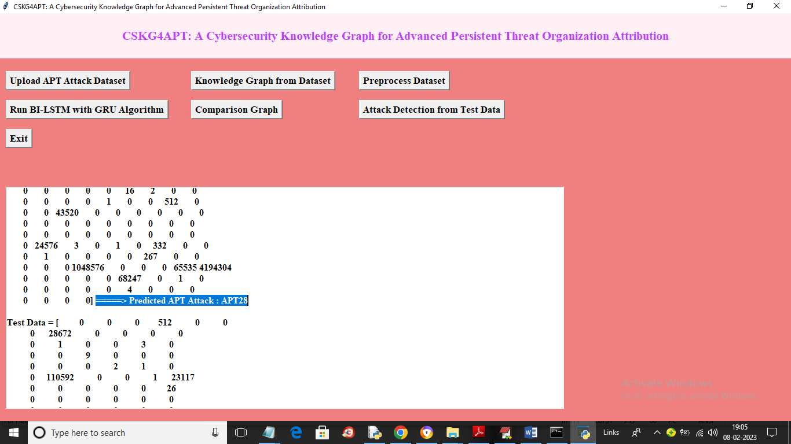
RESULTS
Predicted APT Attack APT28
3. Data Privacy: The project may include measures to protect data privacy in IoT-enabled CPS, ensuring that sensitive information is not compromised during an attack.
4. It gives Robust features such that it can predict different types of attacks.

Slide 23
FUTURE SCOPE
Behavioral Analysis: Develop behavioral analysis models that can detect anomalies in the behavior of IoT devices and cyber-physical systems.
Real-time Monitoring: Implement real-time monitoring and alerting systems that can quickly identify and respond to suspicious activities or anomalies in IoT networks and CPS, enabling the early detection of potential attacks.
Privacy Preservation: Ensure that the project considers privacy preservation techniques, especially when dealing with data collection and analysis in IoT environments, to comply with privacy regulations.
Threat Intelligence Sharing: Encourage the sharing of threat intelligence and attack attribution information within the cybersecurity community to enhance collective defense.
Adaptive Security: Develop adaptive security measures that can dynamically adjust and respond to changing attack patterns and tactics in real-time.
Blockchain and Trust Mechanisms: Explore the integration of blockchain technology and trust mechanisms to enhance the security and traceability of IoT-enabled CPS, making it easier to attribute attacks and secure data.

Slide 24
conclusion
The project focus on developing innovative techniques for detecting and attributing cyber-attacks in these systems using machine learning algorithms.
The project involves cybersecurity, machine learning, and IoT - enabled CPS, consists a more comprehensive view of the problem, leading to effective solutions.
It is essential to implement proper security protocols, such as authentication and encryption, to prevent unauthorized access and data breaches.

Slide 25
REFERENCES
1.Title: "Cyber-Physical Attacks and Defenses in the Smart Grid: A Review"
Authors: Y. Liu, P. Ning, and M. K. Reiter
Published in: IEEE Transactions on Industrial Control Systems, 2011
2.Title: "Cyber Threat Attribution: A Systematic Review"
Authors: K. Scarfone, M. Badger, and T. Nichols
Published in: Computers & Security, 2016
3.Title: "Cyber-Physical Systems Security—A Review"
Authors: R. K. Gupta, J. P. Alves-Foss, and K. R. Pattipati
Published in: IEEE Access, 2017
4.Title: "A Survey on Intrusion Detection in Cyber-Physical Systems"
Authors: M. H. Bhuyan, D. K. Bhattacharyya, and J. Kalita
Published in: IEEE Transactions on Industrial Informatics, 2015

Slide 26
GITHUB LINK
GITHUB LINK for Toward Detection and Attribution of Cyber-Attacks in IoT-enabled Cyber-physical Systems: https://github.com/Sakethpaindla/miniproject

Slide 27
Thank you!!

